Slide 1
Available ES Data 20-21
Notes:
This PowerPoint is representative of the data available to middle school administration in CMCSS as of November 2020.
Note: All current state data is from the school year 2018-2019.

Slide 2

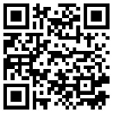
FERPA and Embargoed Data
Please ensure you read all emails containing data carefully.
Traditionally all data is embargoed to the administrators or to individual teachers personal data until at least August of each year.
WEB PAGE
PARKING LOT
Notes:
Just a reminder: Please read emails from the state, district, or the accountability team containing data carefully.
Most data released is embargoed at least temporarily.
You will want to ensure data is controlled based on the information you receive.
If the email does not state you may release the data assume it is embargoed.

Slide 3
Logistics – Accessing Data
The link to the Accountability page is located in the signature block of everyone on the team. You can also access our page through the QR code bottom left or from this address: Accountability.cmcss.net
WEB PAGE
PARKING LOT

Slide 4
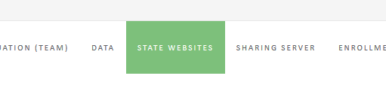
The Accountability Webpage
WEB PAGE
PARKING LOT
Notes:
Our Team Website
One link at the top of the page is to ‘State Websites’

Slide 5
State Website Tab – Accountability Page
Tennessee State Board of Education (TSBA)
Finding teacher license information,
TSBA District Dashboard
WEB PAGE
PARKING LOT
Notes:
The first three links under the State Website Tab are links to TSBA, teacher license look-up, and the TSBA Data Dashboard.
Teacher license information – is a way to look up teacher license numbers, status, and Endorsements
TSBA District Data Dashboard – Provides district and regional labor market statistics and district demographics and academic and financial data.

Slide 6
State Website Tab – Accountability Page
EVAAS/TVAAS
TNReady Pearson Access Next
WEB PAGE
PARKING LOT
Notes:
EVAAS/TVAAS Site – Provides school, teacher, and student level Value Added data.
TNReady Pearson Access Next – Provides reports for TCAP

Slide 7
State Website Tab – Accountability Page
TDOE Assessment Logistics Livebinder
TDOE Assessment Design Livebinder
TNCompass
WEB PAGE
PARKING LOT
Notes:
TDOE LiveBinders – Provides assessment information and released assessment items.
TNCompass – Provides teacher individual growth scores and LOEs.

Slide 8

Accountability Webpage
WEB PAGE
PARKING LOT

Slide 9
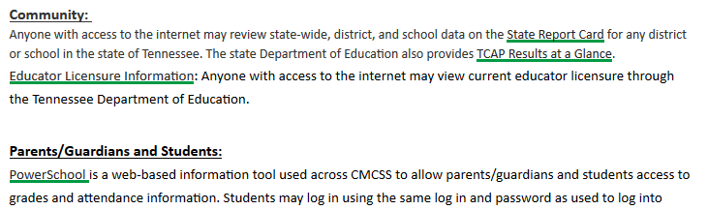
Data Tab – Accountability Page
WEB PAGE
PARKING LOT
Notes:
State Report Card – Provides prior year data for schools and districts across TN
PowerSchool links for parents, guardians, and students

Slide 10

Accountability Webpage
WEB PAGE
PARKING LOT

Slide 11
Sharing Server Tab – Accountability Page
All educators in the Clarksville Montgomery County School System with an active MyLogin may access the district sharing/staff servers. Directions to accessing the server are located. Be sure to follow the appropriate instructions based on your location and type of computer.
Connect to the server from a PC at work
WEB PAGE
PARKING LOT
Notes:
In addition to the links on our web page we have put data controlled by FERPA in the sharing server.
We have provided directions for accessing the sharing server at the bottom of the data page and as a tab at the top of the page.

Slide 12
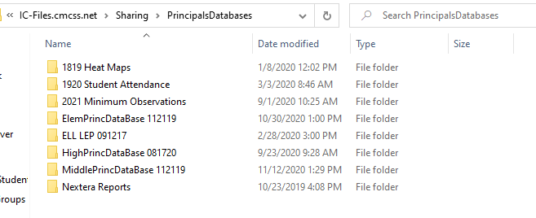
Sharing Server Tab – Accountability Page
WEB PAGE
PARKING LOT

Slide 13
Data Release - Timeline
Unfortunately, we are at the mercy of the state
Release dates are fluid
The Accountability Team has a goal of 24 to 48 hour turn around for an overview of all released data
WEB PAGE
PARKING LOT
Notes:
We are at the mercy of the state when I comes to when data is released and when embargoes are lifted.
Please know, often the state gives us a date and then shifts the date to a later time. They sometimes also release data publicly while giving districts/schools little to no warning.

Slide 14
Proficiency
What I know
Percent of students achieving on-track or mastered
Other words used for Proficiency
Achievement – Percent Proficient –
Growth in Proficiency – Success Rate
WEB PAGE
PARKING LOT
Notes:
Proficiency is the percent of students who reached on-track or mastered on the TNReady.
Proficiency is what the student knows.

Slide 15
Value Added
Did I grow at least one academic year
The average gain in NCEs (K-8)
Other words used for Value Added
Growth – Gains – Meeting Academic Growth
WEB PAGE
PARKING LOT
Notes:
Value added is the difference between the prior year NCE and the current year NCE (K-8).
Value added is the difference between the predicted scale score and the observed scale score (9-12).
Value added is determining if the student grew at least 1 academic year.

Slide 16
Proficiency is not Value Added
Mastered
On-Track
Approaching
Below
Notes:
We have discussed in the past that proficiency and value added are not the same thing. However, some schools have found themselves up in proficiency but down in growth and cannot determine how they are in this scenario.
One way this can occur is when a small number of students cross the line from not proficient to proficient.
During the same year, a larger number of students decrease (in NCEs for K-8 and in Scale Score for 9-12) but do not drop below the proficient line. This could show a significant increase in proficiency while at the same time a significant drop in value added.

Slide 17
Rules for Receiving Value Added
Teacher Value Added (Grades 4-8)
  Minimum of 6 full-time equivalent students
  Students must have taken at least 3 prior assessments
  Students who are not claimed as full are not included in teacher value added (150 days)
WEB PAGE
PARKING LOT
Notes:
The rules associated with receiving value added differs between teacher, school, and district.
10 students – 6 full-time: They only look at whole students. For example, inclusion I only claimed 50% of 10 students I only have 5 students and I will not receive individual growth.

Slide 18
Rules for Receiving Value Added
School Value Added
  Minimum of 30 students with at least 3 prior assessments
  Subgroups must have a minimum of 30 students
  Students must be present 50% or more of the year (90 continuous days at the last school)
WEB PAGE
PARKING LOT
Notes:
The rules associated with receiving value added differs between teacher, school, and district.

Slide 19
Rules for Receiving Value Added
District Value Added
  Minimum of 30 students with at least 3 prior assessments
  Subgroups must have a minimum of 30 students to be included in AMO calculations
  Subgroups must have a minimum of 10 students to be included in reporting
  Students must be present 50% or more of the year (90 continuous days in the district)
WEB PAGE
PARKING LOT
Notes:
The rules associated with receiving value added differs between teacher, school, and district.

Slide 20


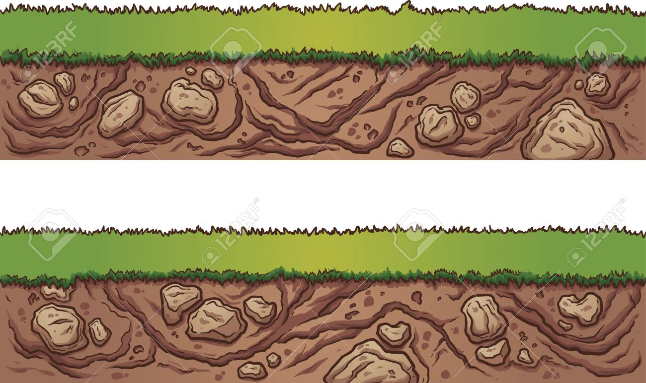
Reaching Mastery
Prior to 2010
TCAP Competency
Gateway
2010 – 2013
TCAP
2013 – 2017
Common Core
TN Diploma Proj
TNReady
2017 – current
TNReady CCR
ACT of 21
EPSOs
Complex Text
Webs Depth of Knowledge

Slide 21
How do we get to the root cause?

Slide 22

Root Causes
MASTERED
ON-TRACK
APPROACHING
BELOW
DISTRICT
BUILDING
STUDENTS
STANDARDS

Slide 23
How do we get to the root cause?
Most focused process is to start with the standards analysis
WEB PAGE
PARKING LOT
Notes:
It is recommended the most focused process for identifying root causes is to start with the standard analysis.

Slide 24
Standards Data
Subscore Report
  Located in the Principals’ Database
WEB PAGE
PARKING LOT
Notes:
When the principal is updated the Accountability Team will include a note in Friday’s notes for 2 to 3 weeks to let you know of any additions.
database
The first item we would like to share is the subscore report.

Slide 25
Subscore Report – Standards Data

Slide 26
Standards Data
Standards Analysis
  Located in Pearson Access Next and on the Sharing Server in the Principals’ Database
WEB PAGE
PARKING LOT
Notes:
The Standards Analysis is currently only available for High School and will not be released on Nextera after this year.
We recommend you download your reports as soon as possible just in case we are locked out of the site soon.

Slide 27
Standards Analysis – Standards Data

Slide 28
Student Data
Individual Student Report (ISR)
  Located in Pearson Access Next – and on the Sharing Server
  Very detailed information about individual students.
  Be mindful of FERPA when using any student data
WEB PAGE
PARKING LOT

Slide 29
ISR Page 1 – Student Data

Slide 30
ISR Page 2 – Student Data

Slide 31
Student Data
Class Roster
  Located in Pearson Access Next – and on the Sharing Server
  Snapshot of students in classes.
WEB PAGE
PARKING LOT
Notes:
Classes are based on how the students were listed by the building testing coordinator.

Slide 32
Class Roster – Student Data

Slide 33
Class Roster
Class Roster – Student Data

Slide 34
Building Level Data
Teacher and School Level Data
WEB PAGE
PARKING LOT

Slide 35
Class Roster – Teacher Data

Slide 36
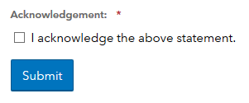
Teacher Data
EVAAS/TVAAS
  Teacher Reports
    Teacher Search
WEB PAGE
PARKING LOT
Notes:
To access the teacher data under teacher search you will first need to acknowledge the confidentiality statement.

Slide 37
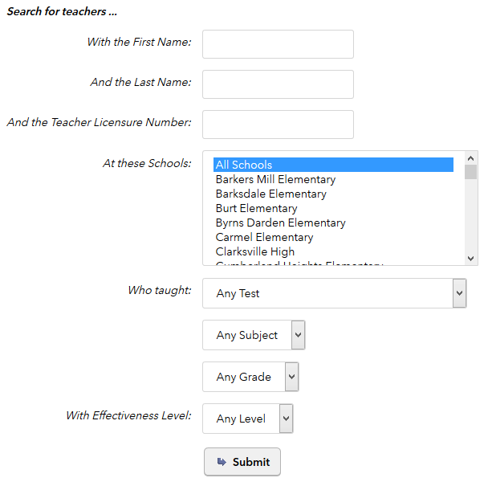
EVAAS Teacher Report – Teacher Data
WEB PAGE
PARKING LOT
Notes:
You may enter 1 teachers name or if you would like to see a full list of the teachers at your building leave the name/license fields blank then click submit.
If you have access to more than one school be sure to select the correct school first.

Slide 38



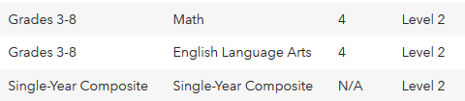
EVAAS Teacher Report – Teacher Data
WEB PAGE
PARKING LOT
Notes:
All Levels – Here is what the page looks like when you open teacher search for a single teacher. You will notice there are three lines for one teacher. There could be three lines. For example, four lines per teacher could be two subjects, a single year composite, a multi-year composite.

Slide 39
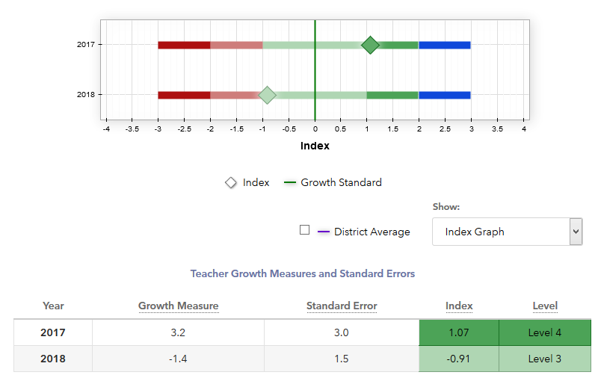
EVAAS Teacher Report – Teacher Data
The subject specific line shows teacher performance for up to 3 years (when available).
WEB PAGE
PARKING LOT

Slide 40
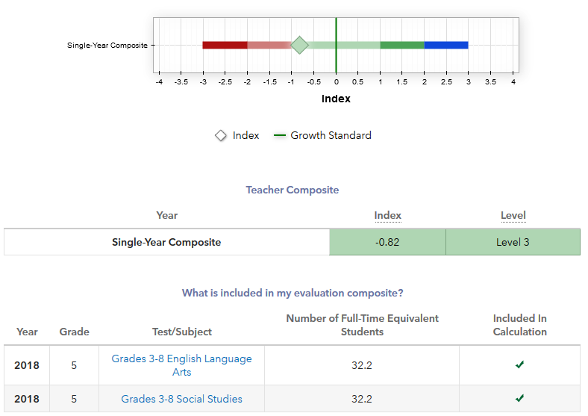
EVAAS Teacher Report – Teacher Data
The Single Year Composite line contains up to 3 evaluation composites from the prior single year
WEB PAGE
PARKING LOT

Slide 41
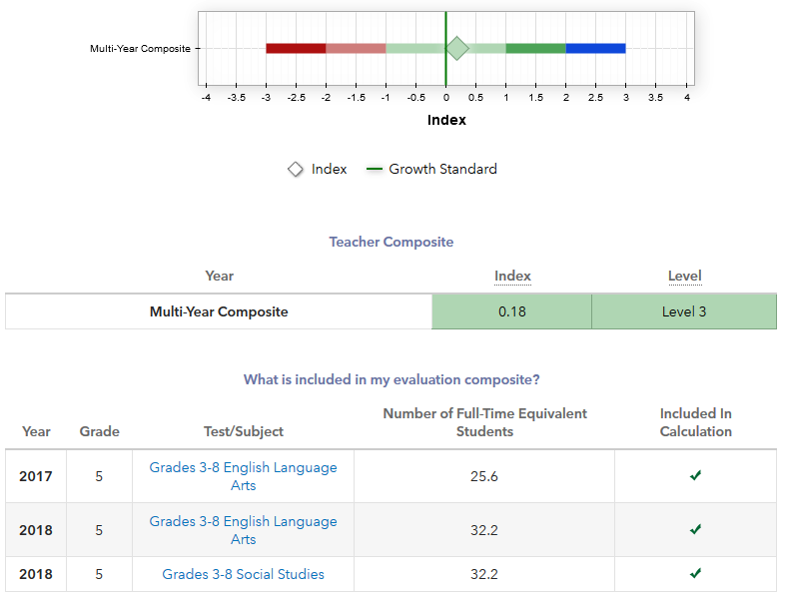
EVAAS Teacher Report – Teacher Data
The Multi-Year Composite line is based on the 3 most recent years of reporting
WEB PAGE
PARKING LOT

Slide 42
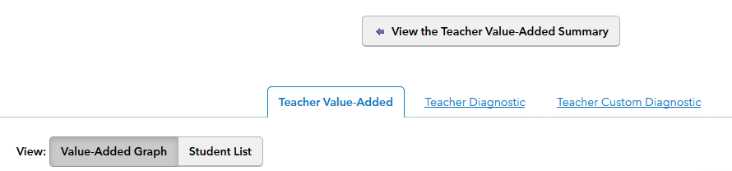
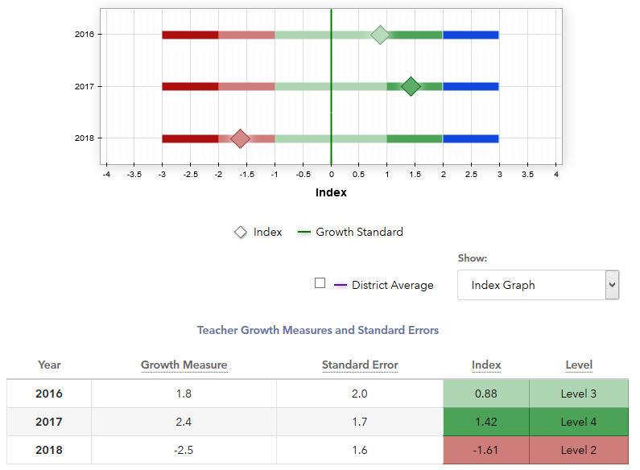
Subject Line – EVAAS Teacher Report
WEB PAGE
PARKING LOT

Slide 43
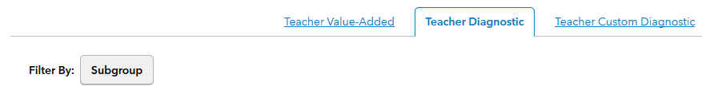
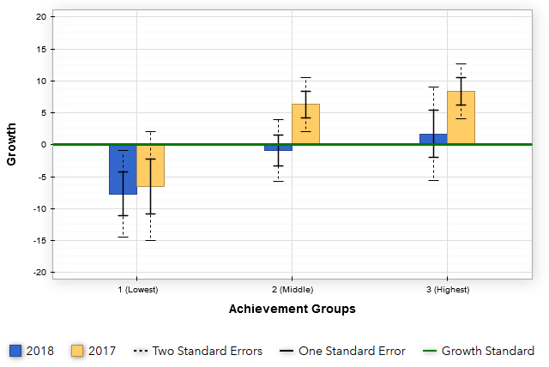
Subject Line – EVAAS Teacher Report
WEB PAGE
PARKING LOT

Slide 44
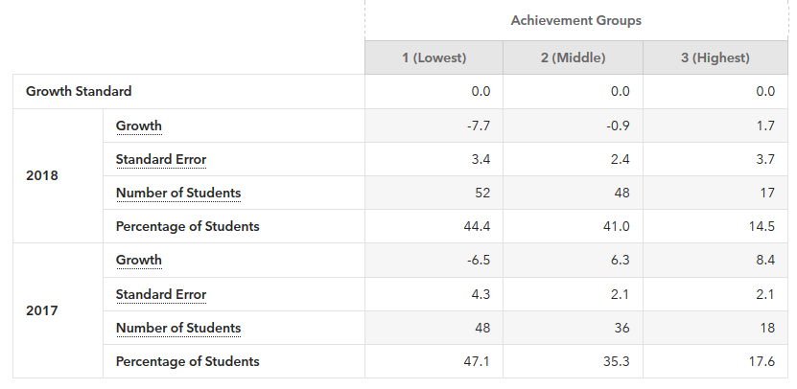
Subject Line – EVAAS Teacher Report

Slide 45
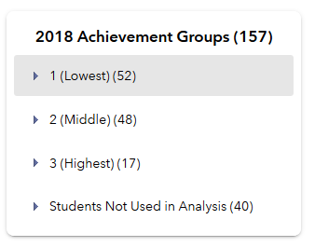
Subject Line – EVAAS Teacher Report
PARKING LOT

Slide 46
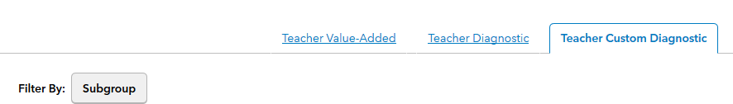
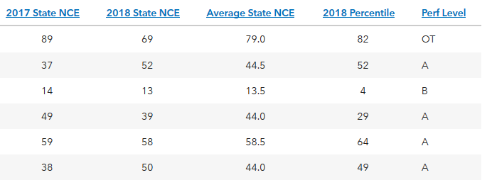
Subject Line – EVAAS Teacher Report
WEB PAGE
PARKING LOT
Notes:
This report also will help with student level data.

Slide 47
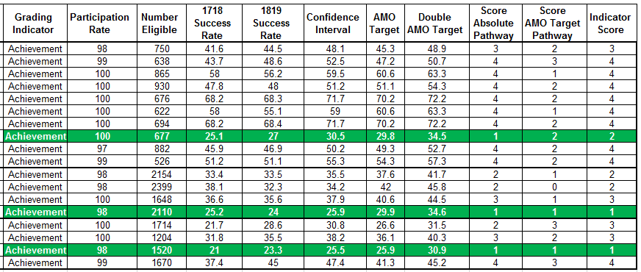
Achievement Measures – School Level Data
Located in the Principals’ Database on the sharing server
Notes:
This chart contains examples of elementary, middle, and high.
The green rows match the school from the subscore report shown earlier.

Slide 48
Subgroup Report – School Level Data
Located in the Principals’ Database on the sharing server
WEB PAGE
PARKING LOT

Slide 49
Subgroup Report – School Level Data
Located in the Principals’ Database on the sharing server
Notes:
High – This matches the school from the subscore report shown earlier.

Slide 50
Subgroup Report – School Level Data
WEB PAGE
PARKING LOT

Slide 51
Subgroup Report – School Level Data
WEB PAGE
PARKING LOT

Slide 52
Subgroup Report – School Level Data
WEB PAGE
PARKING LOT
Notes:
High – This matches the school from the subscore report shown earlier.

Slide 53
Subgroup Report – School Level Data
Notes:
High – This matches the school from the subscore report shown earlier.

Slide 54
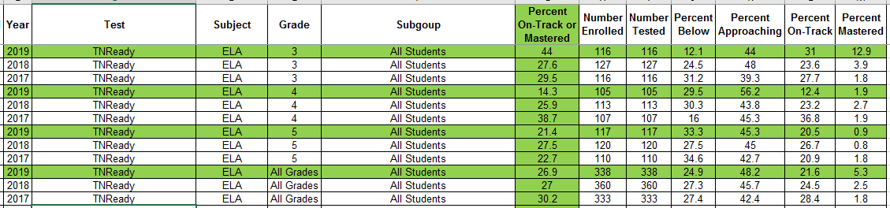
Achievment Data – School Level Data
Located in the Principals’ Database
Includes all subgroups
WEB PAGE
PARKING LOT
Notes:
This matches the school from the subscore report shown earlier.

Slide 55
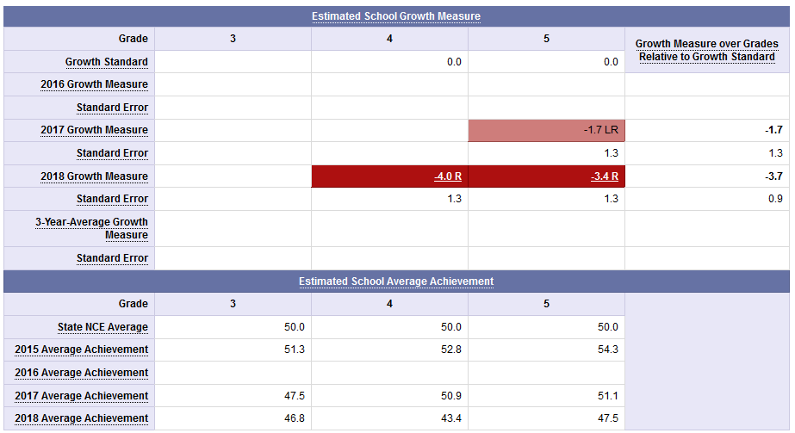
School Value Added – School Level Data
Located in the EVAAS/TVAAS Site
  Reports > School Reports > Value–Added

Slide 56
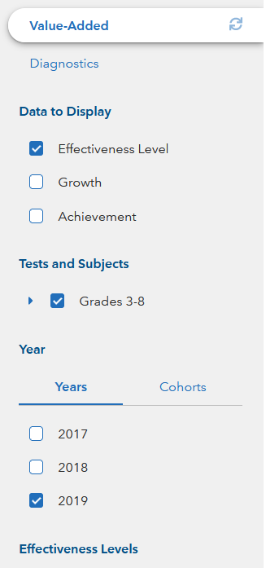
School Value Added – School Level Data
Located in the EVAAS/TVAAS Site
  Reports > School Reports > Value–Added
PARKING LOT

Slide 57
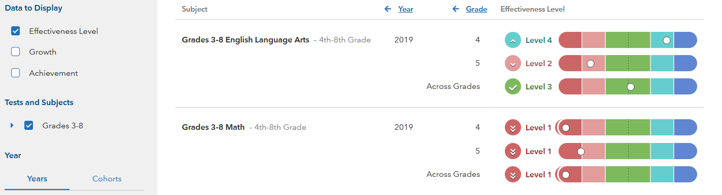
School Value Added – School Level Data
PARKING LOT

Slide 58
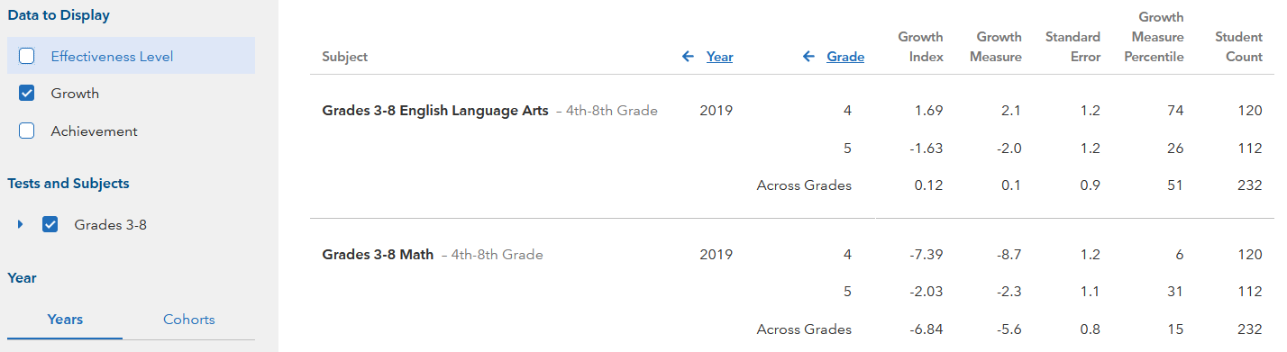
School Value Added – School Level Data
PARKING LOT

Slide 59
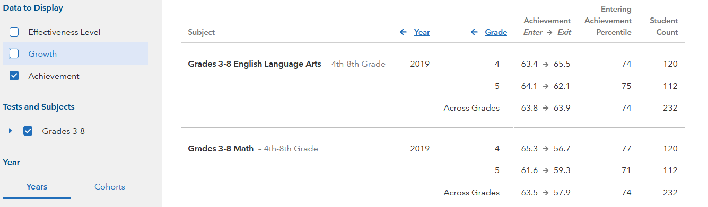
School Value Added – School Level Data
PARKING LOT

Slide 60
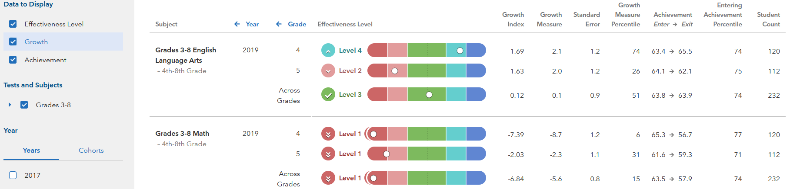
School Value Added – School Level Data
WEB PAGE
PARKING LOT

Slide 61
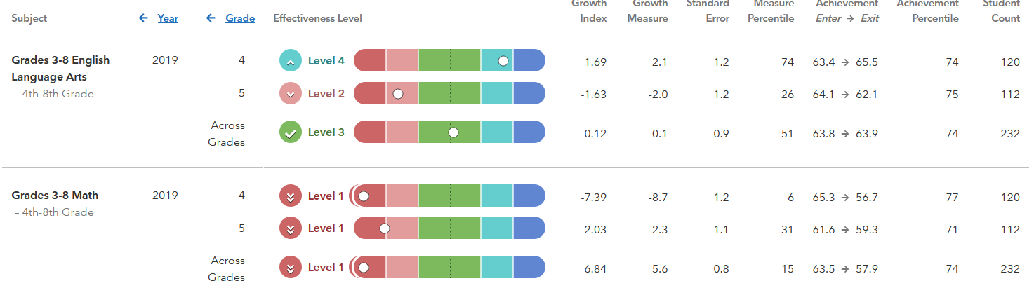
School Value Added – School Level Data
WEB PAGE
PARKING LOT

Slide 62
District and State Data
When available, the district and state data will be posted with the school level data
WEB PAGE
PARKING LOT

Slide 63
Questions?
Parking Lot
WEB PAGE

