Slide 1
2018-2019 Teacher–Student Connections (TSC)

Slide 2
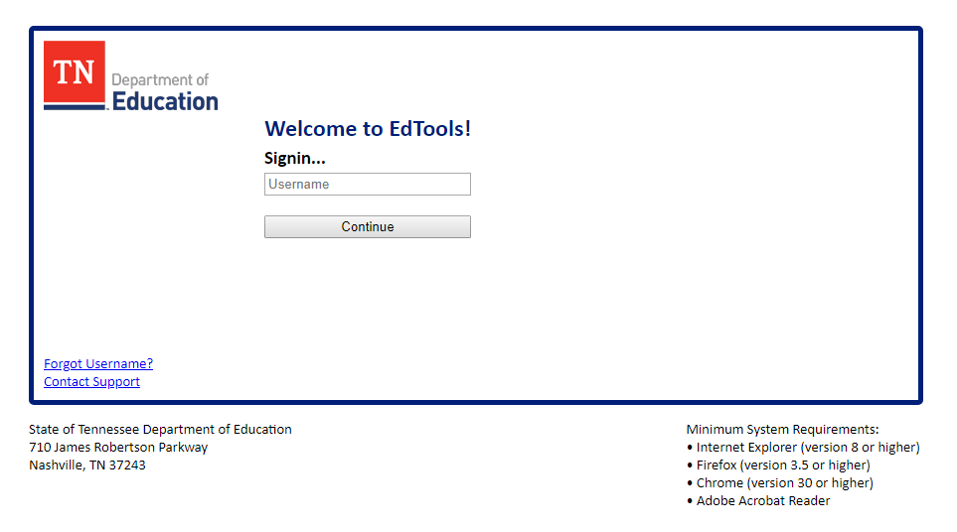
Login to EdTools
Log on to EdTools https://tdoe.randasolutions.com

Slide 3
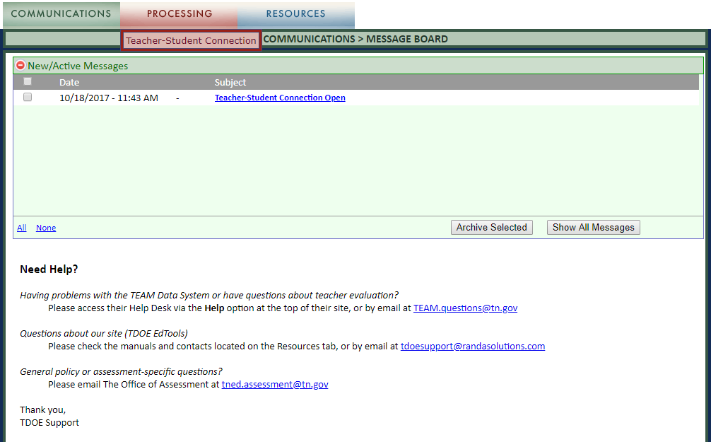
Teacher-Student Connection
The page will refresh to your landing page – the Message Board. Click on the Processing Tab. Select Teacher-Student Connection (TSC)
The page will refresh to your landing page – the Message Board.
Click on the Processing Tab.
Select Teacher-Student Connection (TSC).

Slide 4
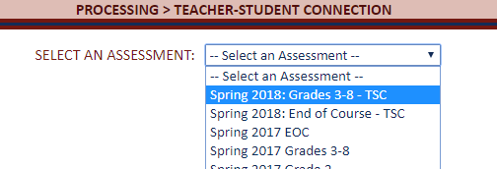
Completing TSC
The page will refresh to TSC.
Use the drop down menu to select an assessment.
TSC will need to be completed for each assessment separately.
Each assessment will be listed separately.

Slide 5
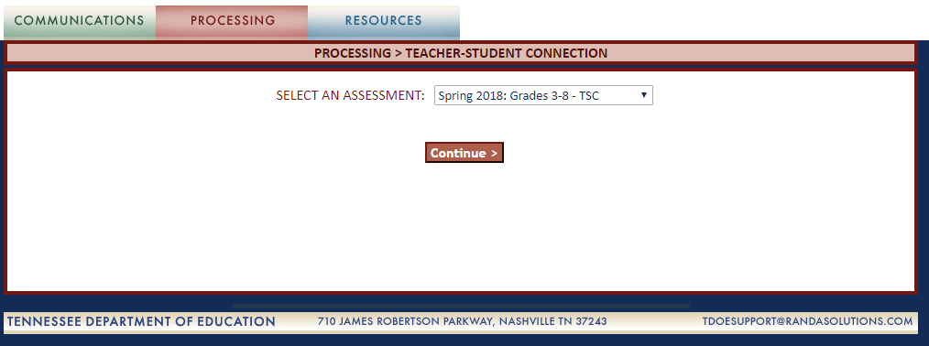
Completing TSC
The page will refresh. Click Continue.

Slide 6
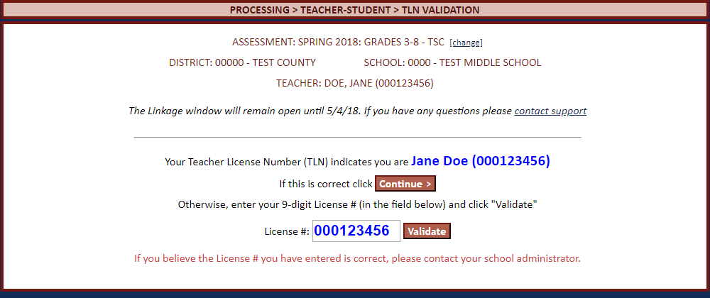
Verify Your TLN
Upon your first login, you will need to verify your Teacher License Number (TLN):
If the Name and TLN indicated are correct, click Continue.
If the Name and TLN indicated are not correct, enter the correct TLN and click Validate.
If you encounter a problem, contact your School Administrator.

Slide 7
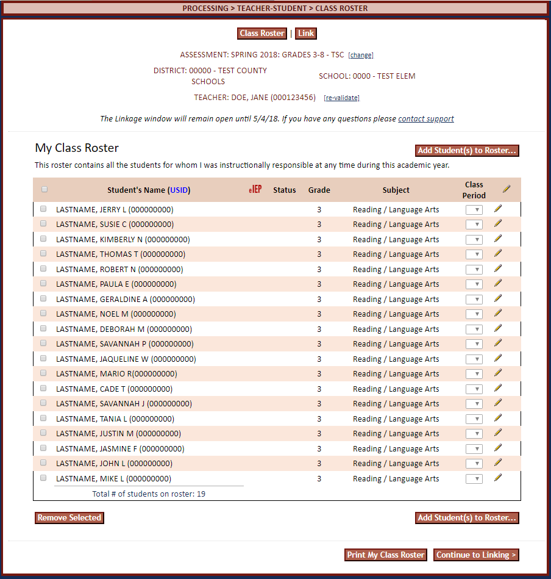
Class Roster
Once you have validated your TLN, each time you login you will land on your class roster.
There are several steps to completing the Class Roster to prepare for Teacher Effect Linkage information.

Slide 8
Class Rosters
Class rosters are automatically created when students are assigned to a Teacher License Number (TLN) through EIS.
The state pulled TLNs based on course codes from EIS.
This guide will outline how to add or delete students from rosters.

Slide 9
eIEP Status
The eIEP column will indicate students who have special education hours in EIS.
The eIEP status in TSC has no effect on teacher-level TVAAS data.

Slide 10
Class Period
Notes:
Class period and Teacher of Record are no longer part of the claiming process.

Slide 11
Editing
To edit the roster for all students,
click the pencil on the upper right to Edit All.
All students will be open to edit.

Slide 12
Empty Rosters
There are a variety of reasons that you may not have a pre-assigned class roster.
When you first log-in you will have a message:
Click Add Student(s) to Roster to create your roster.
Note: There are several reasons that a roster may be empty or students may be missing from a roster. In all cases, add students as described on the following slides.

Slide 13
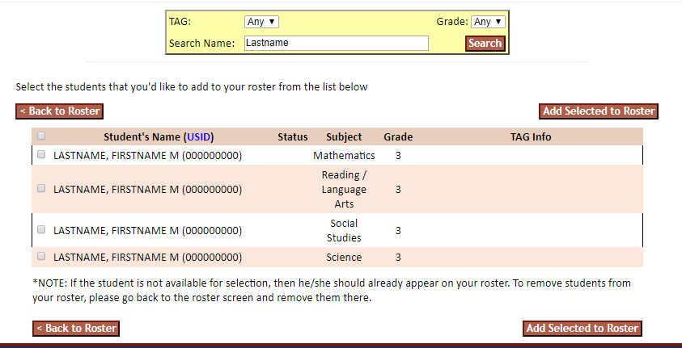
Finding Students
The page will refresh to show all students with the last name entered.
If the student you search for is not found,
contact the EIS Helpdesk (dt.support@tn.gov)

Slide 14
Finish Rostering
Once you have identified all of the students for whom you have been instructionally responsible at any point within the school year, you may click Continue to Linking.

Slide 15
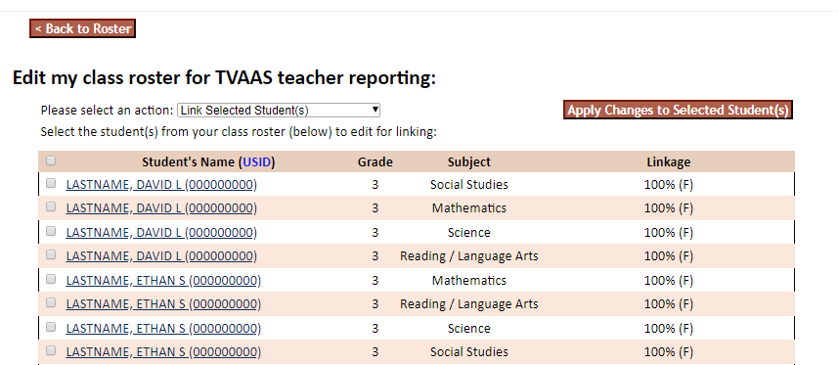
Linking Roster
The page will refresh to your linking roster for Teacher Effect reporting.
To add or remove students to the Linking Roster, click Back to Roster at the top left.
This will return you to the Instructional Roster, where you can make edits as defined in the previous slides.

Slide 16
Linkage Roster
The Linkage Roster shows the percent of instructional time for which you are responsible and the instructional availability of each student.
Instructional time defaults to 100%.
Instructional availability defaults to Full (F).

Slide 17
Ineligible Roster
Students who did not receive instruction in a content area (e.g., an 8th grade student taking Algebra I) will be marked Ineligible for linking.
Only Administrators can add or remove students to the Ineligible Roster.

Slide 18
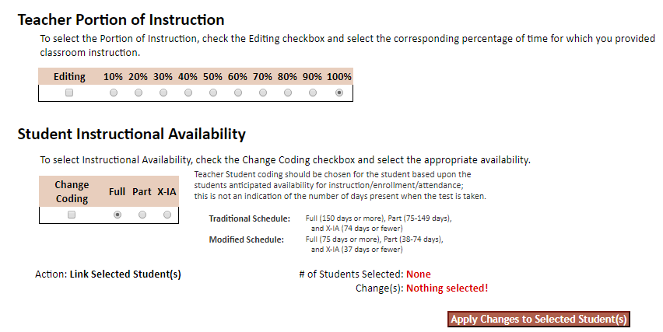
Editing the Linkage Roster
Information relative to the Teacher Portion of Instruction and Student Instructional Availability is at the bottom of the page.

Slide 19
Editing the Linkage Roster
To edit information relative to Teacher percentage or Student Availability, click in the box next to the student(s) to be edited.
Only students marked Full (F) are included in TVAAS calculations, regardless of the percentage entered.
Notes:
Please remind teachers they should not change any instructional availability without permission from administration. In years past we have had teachers who should have been a 5 who received a 3 because they made a change here without permission. Once claiming is closed it cannot be changed.

Slide 20
Instructional availability assumes 100% attendance by all students after April 15, 2019
This is mandated by state policy and not the district
No teacher may change Instructional Availability without permission from their administration

Slide 21
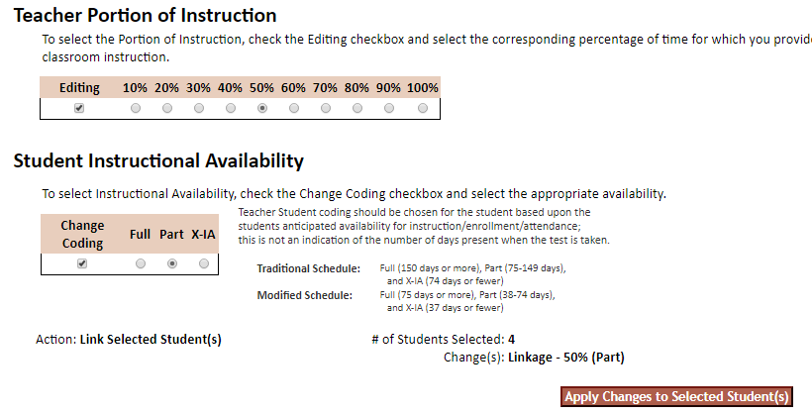
Editing the Linkage Roster
Click the Content area and Percentage to be changed.
Edits can be made individually or in groups for both Percentage and Instructional Availability.
Click Apply Changes to Selected Students when you’ve made your selections. Contact your Administrator if you have questions related to Percentage of Instruction or Student Availability.
If multiple teachers instructed a student, the total percentage claimed between the teachers should equal 100%.
Notes:
Please remind teachers they should not change any instructional availability without permission from administration. In years past we have had teachers who should have been a 5 who received a 3 because they made a change here without permission. Once claiming is closed it cannot be changed.

Slide 22
Finishing Linking
Once you have reviewed/edited the Percentage of Instruction and Student Availability for each student on your Linkage Roster, click the acknowledgement box at the bottom of the page.
The page will refresh, click Print My Linkage Roster or Finish.

Slide 23
You’re Done!
Each time you login after clicking Finish,
the page will refresh to your landing page.
Notes:
It is not required for teachers to turn in a signed document to you showing they finished. However, if you want to collect such a document it would be a good resource in case they wish to later state they did not complete this on their own.

Slide 24
Teacher Claiming Questions
All teacher claiming questions should be sent to their Building Testing Coordinator
Notes:
Please let teachers know if they have any questions during claiming they should contact you. Then if they have any questions you cannot answer or would like any additional help with please email us at assessment@cmcss.net.

Slide 25
TSC Window
Claiming window opens in EdTools – March 18, 2019
Assessment window opens – April 9, 2019
EIS updates to EdTools stops – April 15, 2019
Claimin`g window closes – April 18, 2019
Assessment window closes – April 26, 2019
Notes:
This completes our meeting for the day. Any questions?

