Slide 1
Grant Writing 101

Slide 2
Agenda
Individuals upon completion of the training will be able to
read and analyze professional sample funded grant proposals;
(2) search and access RFPs (Request for Proposals) from various federal, state, and private sources;
(3) develop budgets and timelines appropriate for specific grant proposals;
(4) understand the process for submitting grant proposals to various types of funding sources;
(5) create and plan programs for varying types of grant competitions;
(6) discuss the process involved in grant proposal writing and reviewing.

Slide 3
Grant Funding
Funding 2000-04 Funding 2018 -19
3 Million (average) 15 Million
Funding 2005-13
6 Million (average)
Funding 2013-14
16 Million
Funding 2014-15
14 Million
Funding 2015-16
15 Million
Funding 2016-17
14.9 Million
Funding 2017-18
15 Million

Slide 4
District Policy
Grants Administrative Policy: GRT-A001
Grant opportunities Procedure: GRT-P002
Grant Proposal and Application Procedure: GRT-P003
Grant Post-Award Procedures: GRT-P004

Slide 5
Useful Grant Websites
Identifying Grants
Grants Alert
http://www.grantsalert.com/
Grant Siren List Serve
http://www.grantwriters.net/
Grant Craft
http://www.grantcraft.org
Grants for Teachers
http://www.grants4teachers.com/

Slide 6
Useful Grant Websites
Gathering Data
Educational Data
http://tn.gov/education
https://www.tn.gov/education/data/educator-survey.html
http://nces.ed.gov/
https://www.tn.gov/thec/research/redirect-research/fact-book.html
Community Data
http://www.city-data.com/county/Montgomery_County-TN.html
http://www.city-data.com/city/Clarksville-Tennessee.html
http://quickfacts.census.gov/qfd/index.html
https://opportunityindex.org/
Educational Trends
http://www.edweek.org/ew/index.html
http://www.ascd.org/ProfileRegistration.aspx?signup=smartbrief
http://all4ed.org/take-action/mailing-list/

Slide 7
Grant Writing: Where Do You Start
(1) Who are you?
a. Describe your organization. Remember to include community demographics.
b. Assess your ability to implement, administer, complete and evaluate a project. Consider staff, facilities and community issues. What are your strengths and weaknesses?
c. Complete a needs assessment; survey your students, parents, faculty and community.
(2) Why do you want a grant?
a. Look at your needs assessment and SIP plan.
b. Review the school’s Adequate Yearly Progress (AYP) report identifying achievement gaps and academic weaknesses.
c. Develop a list of goals and objectives you wish to address with grant funds. Identify target populations and justify relationships to goals and objectives.

Slide 8
Grant Writing: Where Do You Start
(3) What will your program look like?
a. What programs will you offer to address your goals and objectives?
b. What research based methodologies and resources do you plan to employ?
(4) What do you need to run the program successfully?
a. How many children do you plan to service?
b. How many individual groups will you have? Is this a whole classroom activity? Are there several classrooms involved? Is this an after-school setting? Effective after-school programs recommend groups of 6-8 students.
c. How many personnel will be necessary?
d. Who will be responsible for what?
e. What transportation, equipment, supplies and materials costs will you incur?

Slide 9
Grant Writing: Where Do You Start
(5) How do you plan to evaluate your success and who will be responsible for the evaluation?
a. Evaluation should include QUALITATIVE data (opinion surveys, interviews, attitude measurements) and QUANTITATIVE data (pre & post assessments, TVAAS scores, attendance data, failure rates, discipline data).
b. Evaluations should be FORMATIVE (allows opportunities to reflect and modify as necessary for the success of the project) and SUMMATIVE (final overall evaluation that describes the progress made and overall benefit of the project).
(6) Sustainability, how do you plan to sustain the program beyond the funds?
a. What structures will you have in place that will allow this project to continue beyond funding?
b. How will the classroom, facility, or system afford to continue this project? What assets do they (personnel, alternative funding, community support, expertise, business partnerships, higher education partnerships, etc).

Slide 10
Grant Writing: Where Do You Start
(7) Now, what funding agency will meet your needs?
a. Project ideas must be aligned with the funding organization’s mission, goals and strategies.
a. Read previously funded grants from an agency if not clear of their interests.

Slide 11
Grant Writing: Why Not Funded
Reason grants are often not funded
(1) A poorly prepared application. Carefully follow the grant application instructions focusing on the requisite format and requirements.
(2) Request of funds fall outside the funding agency or foundations realm of interest.
(3) The grant applicant lacks integrity.
(4) The grant application does not reflect a clear, precise, and comprehensive analysis of the educational facility’s needs. Remember to avoid jargon, explain concepts.

Slide 12
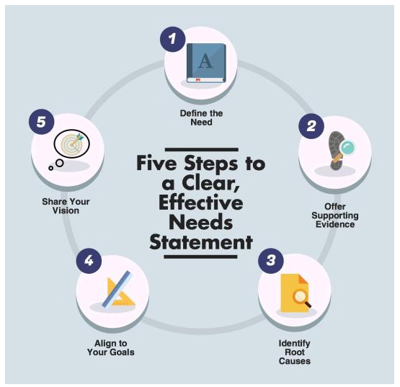
Writing Needs Statement

Slide 13
Writing Needs Statement
Define the Need
Begin by providing context for your need. Typically, this is accomplished with numbers—whether it is demographics or test scores or recent research statistics. These numbers may come from third-party sources, or you may have uncovered them by conducting your own needs assessment. Either way, those numbers must help you tell a compelling story. Weave the numbers into a narrative to engage your reader as you explain how and why you discovered the existence of this need. The narrative offers the opportunity to share not just the quantitative needs, but also the qualitative needs. Remember to address the human interest aspect of the need, as this tactic strengthens a reader’s stake in your application.

Slide 14
Writing Needs Statement
Offer Supporting Evidence
After sharing data that applies to your specific need, broaden your scope to include additional research or evidence to support your needs statement. This may include research on a larger scale such as a state or national report. Essentially, you want to envision the need from 30,000 feet rather than immediately above your school campus. This provides a regional or national context for your need.
Identify Root Causes of the Problem
Once you’ve made the case for your need, do your best to identify the root causes. How and why does this problem exist? If your need is improved kindergarten readiness, a root cause might be the lack of early childhood literacy programs in your area. Or, perhaps it is caused by a lack of preschool books at the local library. It’s likely that there are several contributing factors and it is acceptable to include all of them, provided that you can link them to your identified need—but do not grasp at straws.

Slide 15
Writing Needs Statement
Align to Your Goals
By now, your reader should have a strong understanding of the need and how it came to be. Your next step is to explain how solving this problem aligns to the goals of your school, district, or organization. Let’s go back to the kindergarten readiness example. You want to solve this problem so that your kindergarten students come into school primed and ready to begin their K-12 education adventure. You are qualified to solve this problem because you understand the base of knowledge expected for an incoming kindergarten student, and you have an awareness of the successful strategies necessary to accomplish this goal.

Slide 16
Writing Needs Statement
Share your Vision
Every needs statement must conclude with a peek into the future: the vision. Tell your reader what the landscape will look like once you’ve carried out your project. Be as specific and realistic as possible. If you are requesting $5,000, do not claim that you will entirely obliterate childhood illiteracy in your city; ensure that your vision is in line with the scope and potential of the requested grant. Nobody wants to squash a requester who dreams big, but most funders want to work with people who are realistic about their ability to make an impact.

Slide 17
Alternative Funding Ideas
CMCSS Resource
https://accountability.cmcss.net/grant-writing/alternate-funding-opportunities-and-sources/
Boxtops for Education
http://www.boxtops4education.com/
Fuel Up to 60
https://school.fueluptoplay60.com/home.php
City Savers
https://www.citysaver.com/
Community Opportunities
Lowes
http://responsibility.lowes.com/community/lowes-toolbox-for-education/
WalMart
https://walmart.org/how-we-give/grant-eligibility

Slide 18
Grant Writing 101

